Slide 1

AI-Driven Stock Recommendation: Optimizing Predictions with Hyperparameter Tuning
19CSE451 – Principles of AI Faculty – Pooja Gowda CSE A – Sem V: 2022-26
Team Members: 1. Anvith S G– CSE22007 2. Nithish Kushal Reddy– CSE22043

Slide 2
Basic Terms:
Sector: The industry or category a company belongs to, like IT, pharma, or energy.
Market Cap (Market Capitalization): The total value of a company’s shares on the stock market. Calculated as:
Market Cap = Share Price × Number of Shares
It shows how big or small a company is.
Return on Equity (ROE): Measures how efficiently a company uses its shareholders' money to generate profits. Higher is better.

Slide 3
Basic Terms:
ROCE (Return on Capital Employed): Shows how well a company uses all its capital (debt + equity) to generate profits.
Cash Flow Margin: The percentage of cash flow generated from operating sales. Higher cash flow margin means more money is retained for future use.
EBITDA Margin: How much profit a company makes before deducting interest, taxes, depreciation, and amortization, as a percentage of revenue.

Slide 4
Basic Terms:
Net Profit Margin: The percentage of revenue that remains as profit after all expenses.
Return on Assets (ROA): Measures how efficiently a company uses its assets to generate profit.
5Y CAGR (5-Year Compound Annual Growth Rate): The average annual growth rate of a company over the past 5 years.

Slide 5
Basic Terms:
Asset Turnover Ratio: Shows how efficiently a company generates revenue from its assets.
Inventory Turnover Ratio: Indicates how quickly a company sells and replaces its inventory.
Working Capital Turnover Ratio: How well a company uses its working capital (current assets - current liabilities) to generate revenue.

Slide 6
Basic Terms:
Interest Coverage Ratio: Measures how easily a company can pay its interest expenses. Higher is better.
Current Ratio: Compares a company’s short-term assets to short-term liabilities to assess liquidity.
Debt to Equity: Indicates the proportion of debt compared to shareholders’ equity. Lower is generally better.

Slide 7
Basic Terms:
Debt to Asset: Measures the percentage of a company’s assets financed by debt.
PE Ratio (Price to Earnings): Tells how much investors are willing to pay for ₹1 of the company’s earnings.
PB Ratio (Price to Book): Compares the market price to the book value of the company.

Slide 8
Basic Terms:
Sector PE: Average PE ratio for all companies in the same sector.
Sector PB: Average PB ratio for all companies in the same sector.
PS Ratio (Price to Sales): Compares the market price to the company’s revenue.
Dividend Yield: How much a company pays in dividends relative to its share price.

Slide 9
Basic Terms:
Sector Dividend Yield: Average dividend yield for all companies in the same sector.
Return on Investment (ROI): Measures the profit made on an investment compared to its cost.
MF Holding Change 3M/6M: Change in holdings of the company’s shares by Mutual Funds over the last 3 or 6 months.

Slide 10
Basic Terms:
FII Holding Change 3M/6M: Change in holdings of the company’s shares by Foreign Institutional Investors over the last 3 or 6 months.
DII Holding Change 3M/6M: Change in holdings of the company’s shares by Domestic Institutional Investors over the last 3 or 6 months.
EPS (Q) (Earnings per Share, Quarterly): Profit per share in a specific quarter.

Slide 11
Basic Terms:
Dividend Per Share: Total dividend paid per share during a specific period.
Sub-Sector: A smaller classification within the main sector, for example, "IT Services" under "Technology".

Slide 12
Overview
Introduction
Literature Review
Identified Gaps
Problem statement
Sub objectives
Design Architecture
Agent wise explanation of your project
Results and Discussion
Conclusion and Future Work

Slide 13
Introduction:
Explain the growing role of Artificial Intelligence (AI) in solving complex problems in financial markets.
Highlight the significance of integrating value-investing principles with advanced machine learning algorithms.
Introduce the project as an AI-driven stock recommendation system for Indian markets, emphasizing long-term investment strategies.

Slide 14
Problem Statement:
Identifying fundamentally strong stocks in the Indian stock market is challenging.
The market's dynamic nature and inherent volatility add to the complexity.
Investors struggle to find stocks trading below their intrinsic value.
This difficulty hinders making informed and profitable investment decisions.

Slide 15
AI Agents
Environment: Indian stock market data with attributes like financial ratios, valuation metrics, and market trends.
Actuators: Machine learning algorithms (Random Forest, Decision Tree, XGBoost).
Preceptors: Observations such as ROE, Debt-to-Equity, and PE Ratio to make predictions.
Action Space: Classification of stocks into "Not Recommended," "Recommended," and "Highly Recommended.“
State Space: Transition from raw data to actionable insights through preprocessing, feature transformation, and model prediction.

Slide 16
Agent-Based Framework: AI agent processes raw financial data (percepts) to generate actionable stock recommendations.
Start State: Raw dataset from Ticker Tape with 4,245 records and 31 attributes, including financial ratios and sectoral benchmarks.
Goal State: Classify stocks into:
0: Not Recommended
1: Recommended
2: Highly Recommended
Actuators: Machine learning models:
Random Forest
Decision Tree
XGBoost

Slide 17
Literature Review
S.No | Paper Title | Author(s) | Year | Objective | Advantages
1 | A Systematic Literature Review on AI based Recommendation Systems andtheir Ethical Considerations | Masciari, Elio, Areeba Umair, and Muhammad Habib Ullah | 2024 | Conduct a systematic review of AI-based recommendation systems, focusing on ethical considerations. | Highlights the importance of transparency, fairness, and ethical AI practices in financial applications.
2 | Machine learning-based stock pickingusing value investing and quality features | Priel, Ronen, and Lior Rokach | 2024 | Use machine learning to enhance value investing by identifying underpriced stocks with quality features. | Demonstrates the ability of machine learning to reinforce traditional investment strategies.
3 | Machine learning-based stock pickingusing value investing and quality features | Priel, Ronen, and Lior Rokach | 2023 | Similar to the previous, focuses on developing a robust value-based investment framework. | Confirms machine learning's potential in streamlining and improving investment models.
4 | Development and Evaluation ofa Machine Learning-Based Value Investing Methodology | He, Jun Yi Derek, and Joseph Ewban | 2023 | Develop a machine learning-based value investing model using complex data pipelines. | Validates the strength of machine learning in replicating and extending traditional investment strategies.

Slide 18
Literature Review
S.NO. | PAPER TITLE | AUTHORS | YEAR | OBJECTIVE | ADVANTAGES
5 | Development and Evaluation ofa Machine Learning-Based Value Investing Methodology | He, Jun Yi Derek, and Joseph Ewbank | 2020 | Similar to the previous, focuses on integrating machine learning for stock selection based on value principles. | Reinforces the reliability and effectiveness of combining value investing with AI.
6 | SPCM: A Machine Learning Approachfor Sentiment-Based Stock Recommendation System | Wang, Jiawei, and Zhen Chen | 2023 | Combine sentiment analysis and price data in stock recommendation systems using machine learning. | Addresses holistic evaluation challenges and improves recommendation accuracy with sentiment insights.
7 | Empirical asset pricing viamachine learning | Gu, Shihao, Bryan Kelly, and Dacheng Xiu | 2020 | Explore machine learning methods for empirical asset pricing in financial markets. | Shows the suitability of ML techniques for measuring risk premia and advancing asset pricing models.
8 | Stock Recommendations for Individual investors | Lee, Youngbin, Yejin Kim, and Yongjae Lee. | 2024 | Propose a solution for stock recommendations using XGBoost Model. | XGBoost enhances recommendation accuracy.

Slide 19
Literature Review
S.NO. | PAPER TITLE | AUTHORS | YEAR | OBJECTIVE | ADVANTAGES
9 | When ai meets finance (stockagent): Large lan-guage model-based stock trading in simulated real-world environments | Zhang, Chong, et al | 2024 | Introduce StockAgent, a multi-agent AI system for simulated real-world stock trading. | Demonstrates the potential of large language models in financial decision-making and trading.
10 | A bi-directional evolution algorithm for financial recommendation mode | Xue, Jingming, et al | 2024 | Develop a bi-directional evolution algorithm for financial recommendation models. | Improves adaptability and accuracy in stock predictions with evolutionary approaches.
11 | Financial applications of machine learning: A literature review. | Nazareth, Noella, and Yeruva Venkata Ramana Redd | 2022 | Review machine learning applications across various financial domains, including stock recommendations. | Highlights the growing importance of ML techniques in finance, particularly deep learning methods.

Slide 20
Literature Review
S.NO. | PAPER TITLE | AUTHORS | YEAR | OBJECTIVE | ADVANTAGES
12 | DeepValue: a comparable framework for value-based strategy by machine learning | Huang, K. J | 2020 | Develop the DeepValue framework for value-based investment strategies using deep learning. | Provides a scalable, comparable framework for company valuation using ML techniques.
13 | Artificial intelligence applied to stock market trading: a review | Ferreira, Fernando GDC, Amir H. Gandomi, and Rodrigo TN Cardoso. | 2023 | Review the application of AI in stock market trading, with a focus on trading strategies. | Highlights the versatility and impact of AI in improving trading decisions and strategies.
14 | An ensemble machine learning approach forforecasting credit risk of agricultural SMEs’ | Belhadi, Amine, et al. | 2020 | Forecast credit risks using ensemble machine learning techniques in agricultural investments. | Improves forecasting accuracy and risk management in niche financial applications.
15 | MachineLearning for Excess Return Exploration in Investment Strategies | Shen, Q., Yuan, W., & Jin, Y. | 2024 | Introduce AlphaMLDigger, an ML-based tool for exploring excess returns in volatile markets. | Demonstrates how ML can mine actionable insights for investment strategies in volatile environments.

Slide 21
Research Gap and Novelty
Low and high prices during a time interval provide an indication of the stock's volatility, which is a key factor in financial forecasting.
These prices help in identifying bullish (upward) or bearish (downward) trends by analyzing patterns over time.
Financial data is noisy, and extreme low and high values may not always reflect genuine market trends but rather anomalies.
Using low and high prices is often more effective for short-term predictions, which may not align with long-term investment goals.
Actionable multi-class classification, robust handling of class imbalance, advanced hyperparameter tuning, and deployment of a real-time Flask-based stock recommendation system.

Slide 22
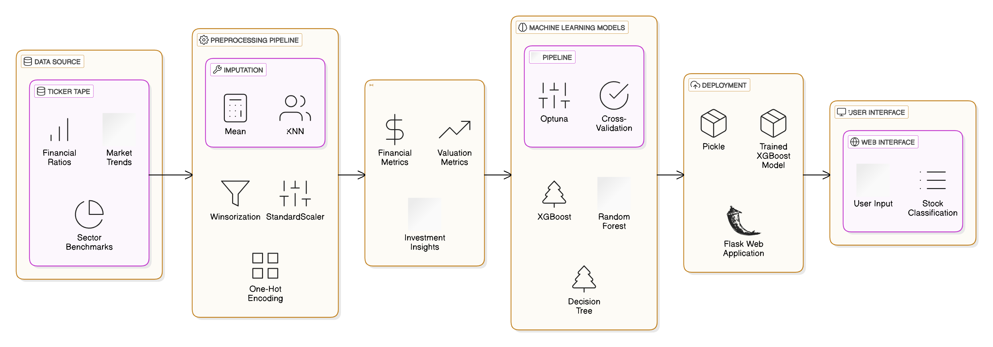
System Architecture

Slide 23
Methodology -

Slide 24
Data Preprocessing
Data Cleaning:
Imputed missing values using mean and KNN Imputer.
Set undefined holding changes to 0.
Outlier Treatment:
Applied Winsorization to cap extreme values in metrics like PE Ratio and ROCE.
Feature Transformation:
Numerical Features: Standardized with StandardScaler.
Categorical Features: Encoded using One-Hot Encoding.
Pipeline Integration:
Automated preprocessing, ensuring consistency and efficiency for cross-validation and model evaluation.

Slide 25
Model Selection & Training
Random Forest:
Ensemble learning model combining multiple decision trees.
Handles variance and provides robust predictions.
Decision Tree:
Simple, interpretable, and rule-based for quick decision-making.
XGBoost:
Gradient boosting algorithm for high precision and performance.
Handles class imbalance effectively.
Training Approach:
Pipelined data processing.
Models trained and validated using stratified K-fold cross-validation to address class imbalance and prevent overfitting.

Slide 26
Hyperparameter Tuning
Optimization Framework: Optuna
Automated hyperparameter search to maximize model performance.
Utilized pruning to eliminate poorly performing configurations early.
Parameters Tuned:
Random Forest: Number of trees, depth, and splits.
Decision Tree: Depth, criteria, and splits.
XGBoost: Learning rate, number of estimators, subsample ratio, and column sampling.
Outcome:
Improved accuracy and AUC-ROC metrics for all models.
XGBoost achieved the best balance of accuracy and generalization.

Slide 27
Deployment
Best Model: XGBoost selected for deployment based on superior performance.
Framework:
Serialized the model and preprocessing pipeline using Pickle.
Developed a Flask-based web application for real-time predictions.
User Workflow:
Input financial metrics like ROE, PE Ratio, etc.
System processes the data and predicts stock categories in real-time.
Impact:
Provides a seamless, user-friendly interface for investors to make informed decisions.

Slide 28
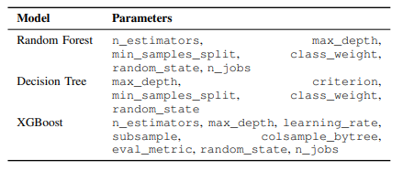

Slide 29
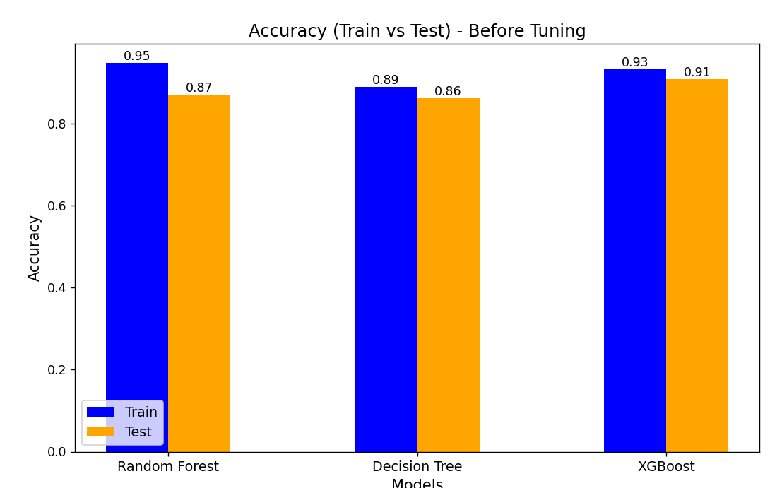
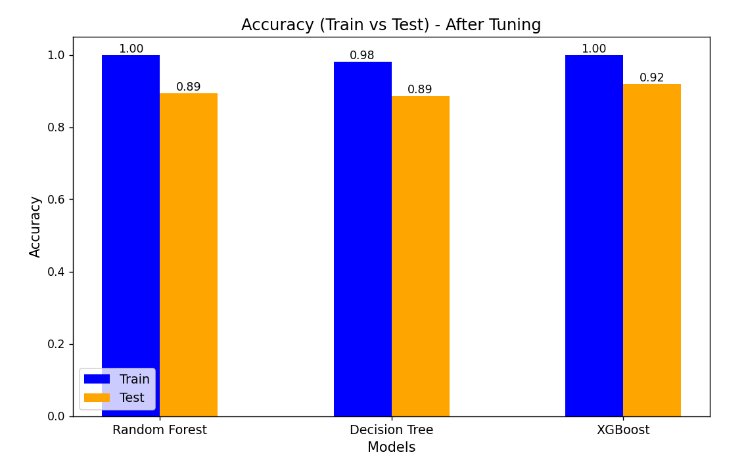
Results

Slide 30
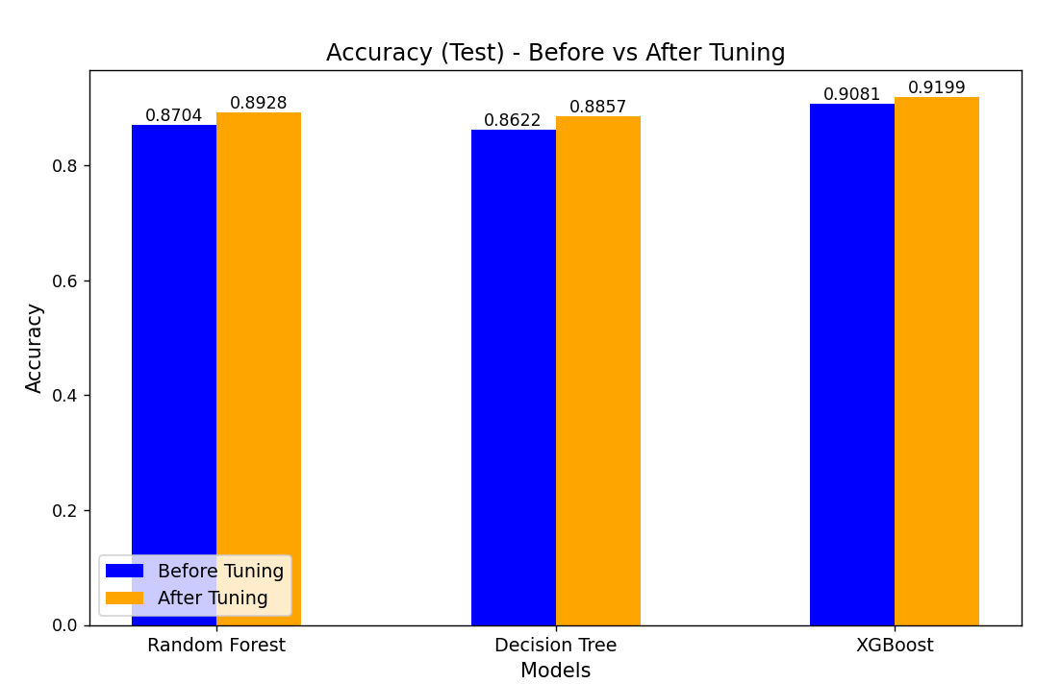
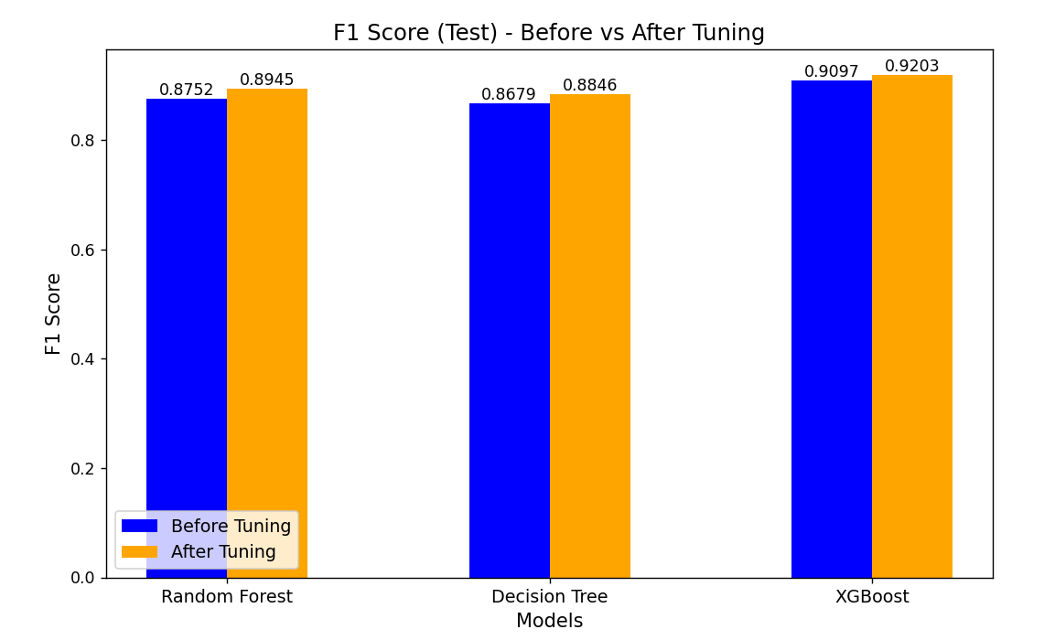
Results

Slide 31
Conclusion and Future Scope
Incorporate real-time market data via APIs for dynamic predictions.
Global markets operate under varied economic, regulatory, and financial conditions. To expand, the system needs to accommodate different financial metrics, such as country-specific valuation ratio.

